Slide 1
Text Classification GNG 5125 Data Science Application-Group 2
Presented by:
Mohamed Abdalla
Stephanie Kahindo
Raha Salimi
Fatemeh Soltani

Slide 2
Table of Content
1
Environment Setup
4
Machine Learning Model
2
Data Preparation
5
Champion Model
3
Data Transformations
6
Conclusion

Slide 3
List of Libraries
Data Manipulation Libraries :
numpy, pandas, re, gensim, sklearn.manifoldcollections.
Natural Language Processing Libraries:
nltk, stopwords, punkt, RegexpTokenizer.
Data Visualization Libraries:
matplotlib, seaborn.
Scikit-learn Packages:
Pipeline, FeatureUnion, CountVectorizer, TfidfTransformer, train_test_split, cross_val_score,
classification_report, confusion_matrix, accuracy_score, precision_score,
recall_score, f1_score, RandomizedSearchCV, word2vec.
Machine Learning Models:
RandomForestClassifier, SVC, KNeighborsClassifier.

Slide 4
Data Preparation/Pre-processing
Book Selected
# | Book Name | Genre | Author
1 | The Tragedy of Macbet | Tragedy/Drama | William Shakespeare
2 | King Arthur's Socks and Other Village Plays | Drama | Floyd Dell
3 | The Road to Damascus | Drama | August Strindberg
4 | Queen Mary and Harold | Drama | Alfred Lord Tennyson
5 | Romeo and Juliet | Tragedy/Drama | William Shakespeare
Pre-processing
Data Tokenization
Stop-words
Stemming
Removed number/special characters
Selected 200 documents of 100 words each.

Slide 5
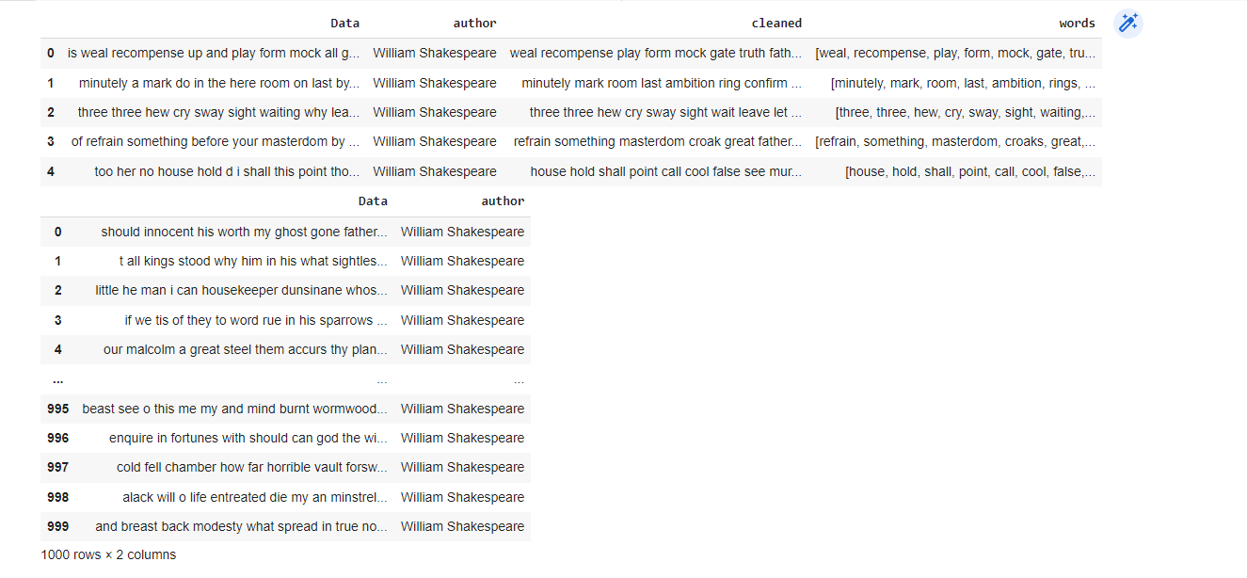
Data Preparation/Pre-processing
Remove stop words ,stemming and lemmatization

Slide 6
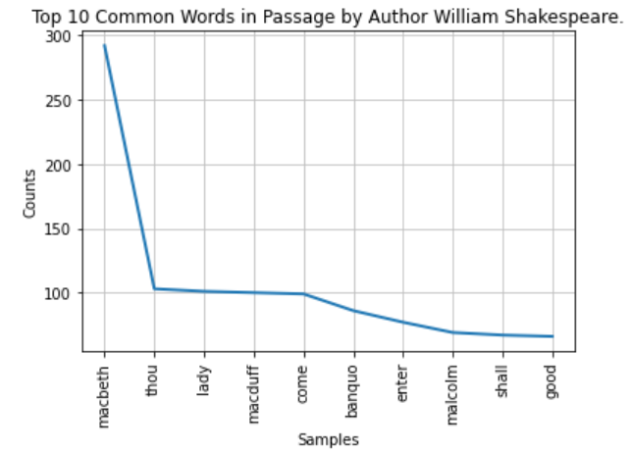
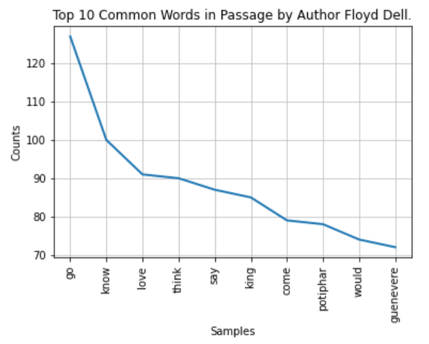
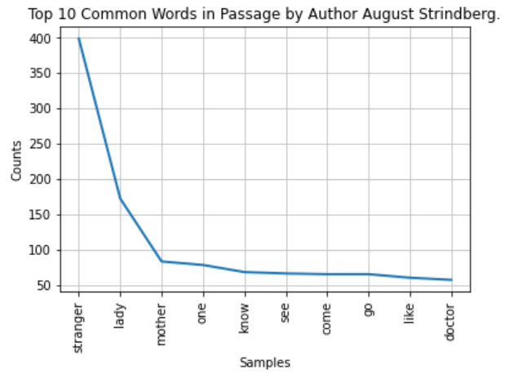
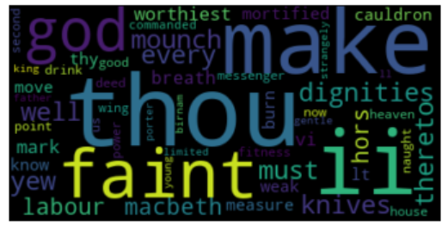
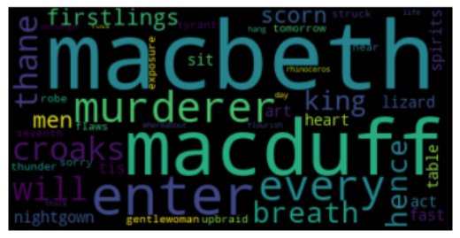
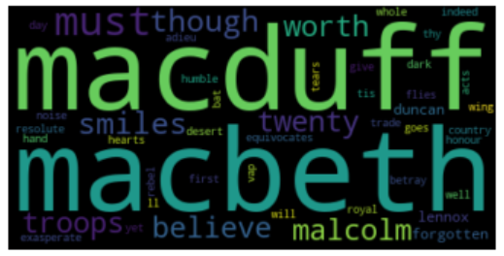
Data Visualization
Book1
Book2
Book3

Slide 7
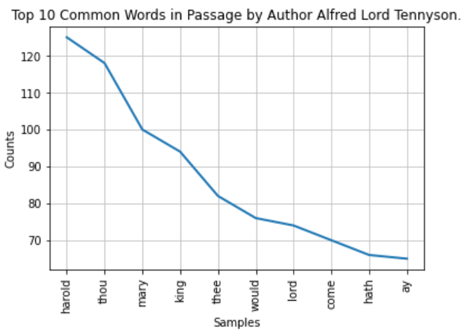
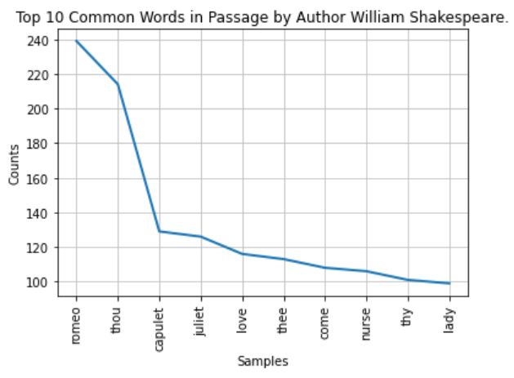
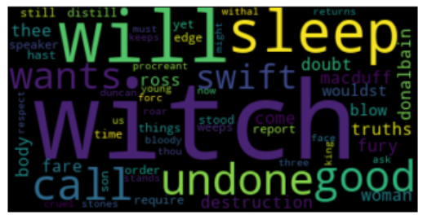
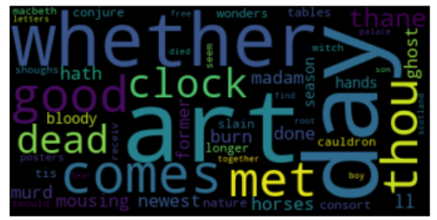
Data Visualization
Book4
Book5

Slide 8
Data Transformation
Bag of Words
The bag-of-words (BoW) describes the occurrence of words within a document. It involves a list of vocabulary words and the frequency of the vocabulary within the document. The model is only concerned with whether known words occur in the document, not where in the document.
TF-IDF
TF-IDF (term frequency-inverse document frequency) is a statistical measure that evaluates how relevant a word is to a document in a collection of documents. This is done by multiplying 2 metrics: how many times a word appears in a document, and the inverse document frequency of the word across all documents.
Doc2Vec
Every paragraph in the training set is mapped to a unique vector represented by a column in the matrix(this being the authors label) and every word is mapped to a unique vector represented by another matrix(the sentences) the paragraph and word vectors are averaged to predict the next word in a given context.
LDA
Latent Dirichlet Allocation is a statistical model. Similar to Bag-of-Words, it shows the occurrence of words for a given topics, and the number of topics for a given document or data set. In short, LDA will randomly take words from a text and assigned to those words to specific topics.

Slide 9
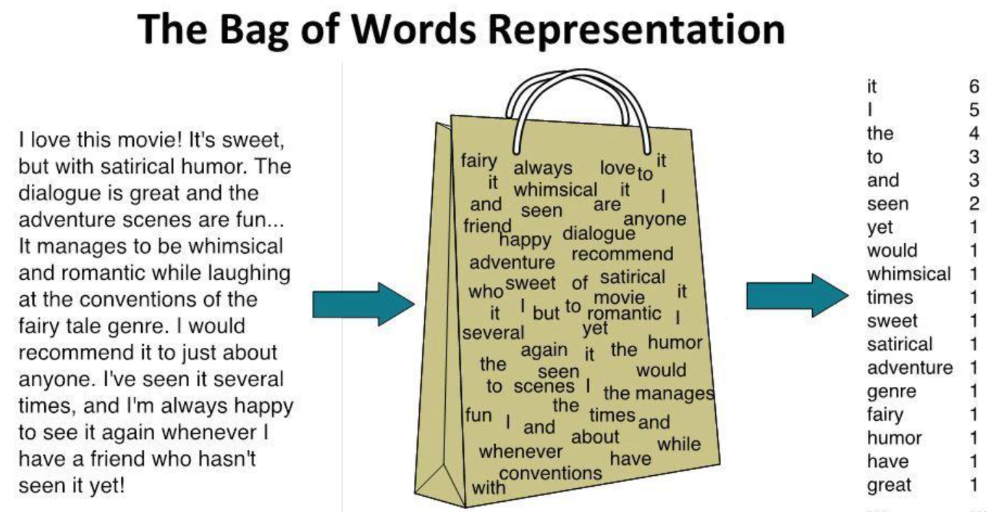
Bag of Words
Pros
Simple to understand and implement
Flexible for text customization
Cons
The assigned vocabulary vector is huge
Sparce memory will be occupied
Lose all information about word order
No info of vocabulary meaning “John likes Mary” or “Mary likes John”
https://sep.com/blog/a-bag-of-words-levels-of-language/
Notes:
It has been used with great success on prediction problems like language modeling and documentation classification.
Nevertheless, it suffers from some shortcomings, such as:
Vocabulary: The vocabulary requires careful design, most specifically in order to manage the size, which impacts the sparsity of the document representations.
Sparsity: Sparse representations are harder to model both for computational reasons (space and time complexity) and also for information reasons, where the challenge is for the models to harness so little information in such a large representational space.
Meaning: Discarding word order ignores the context, and in turn meaning of words in the document (semantics). Context and meaning can offer a lot to the model, that if modeled could tell the difference between the same words differently arranged (“this is interesting” vs “is this interesting”), synonyms (“old bike” vs “used bike”), and much more.

Slide 10
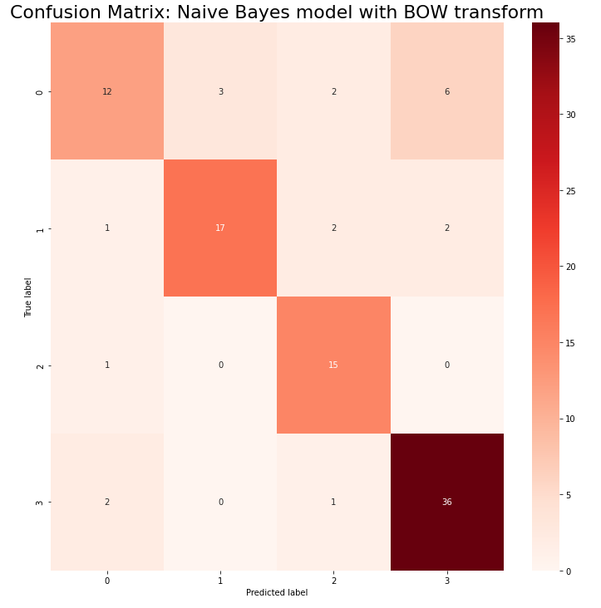
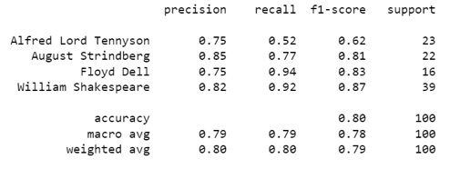

Fitting LR, RF, KNN, SVM classifier on NB model

Slide 11
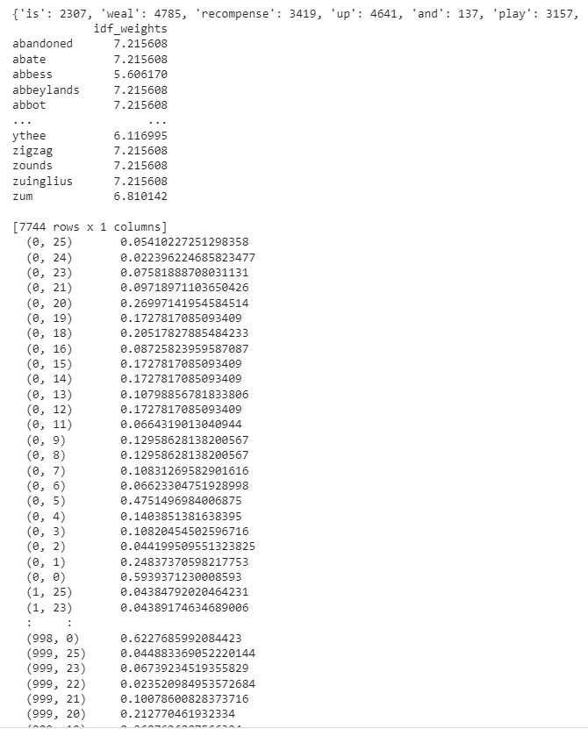

TF-IDF

Slide 12
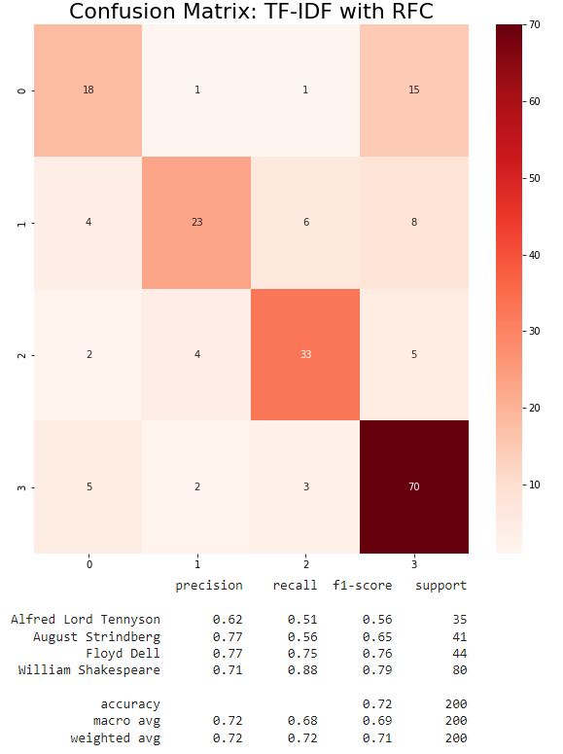
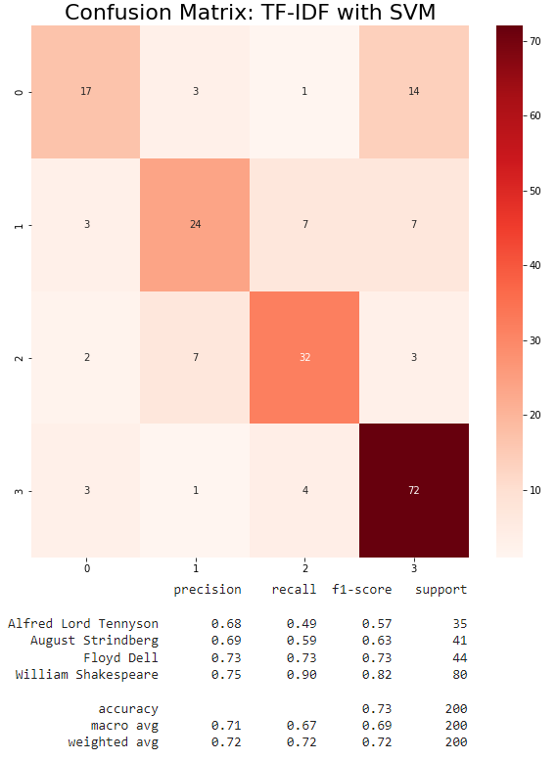
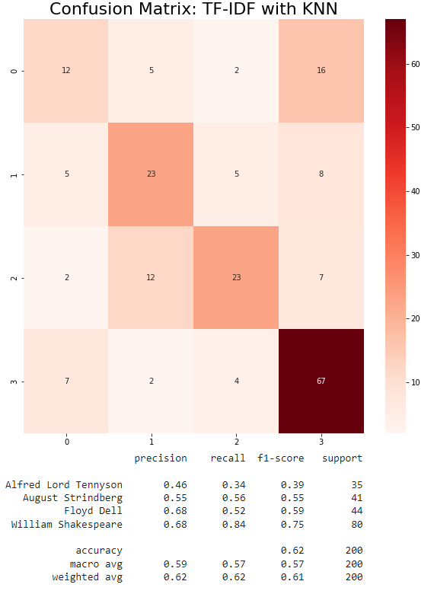
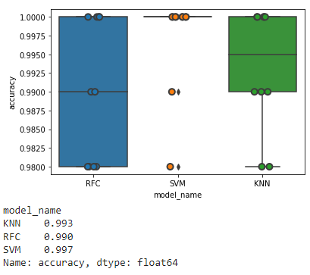

Fitting RF, SVM ,KNN classifier on TF-IDF

Slide 13
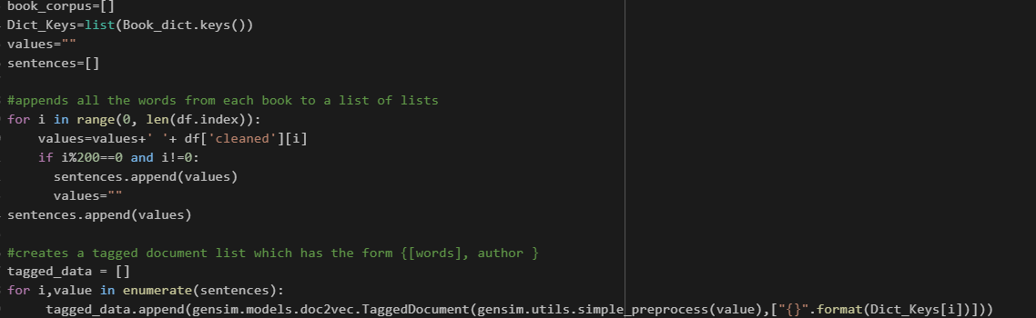

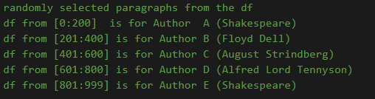

Doc2Vec

Slide 14
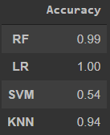
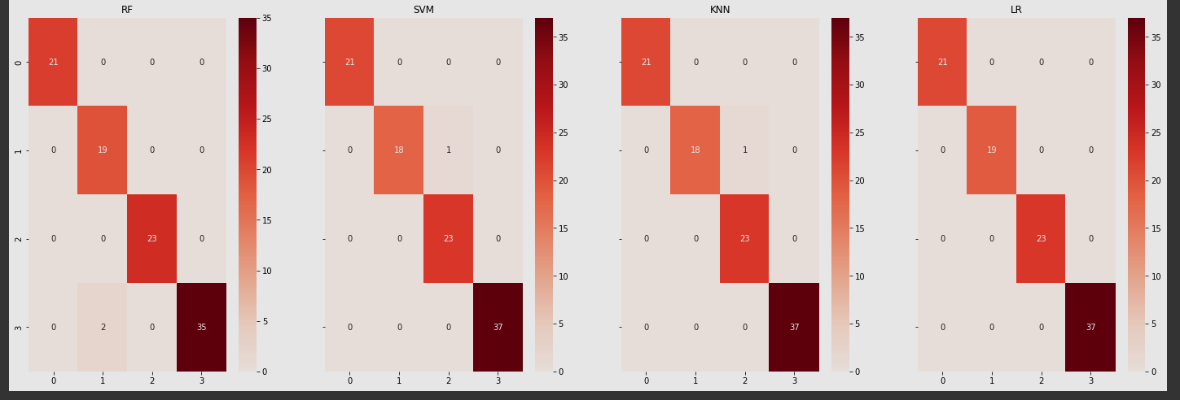
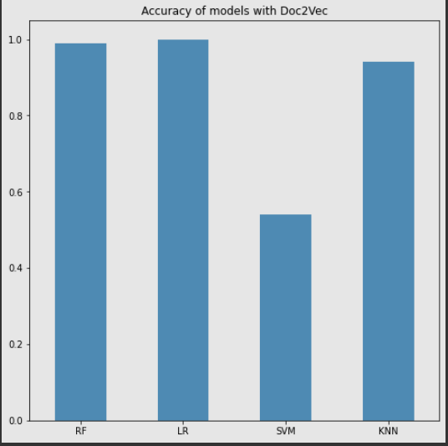
Fitting LR, RF, KNN, SVM classifier on doc2vec
-Created train and tagged data set and trained them
- create the vector and split it to target and words
- run the vector on models

Slide 15
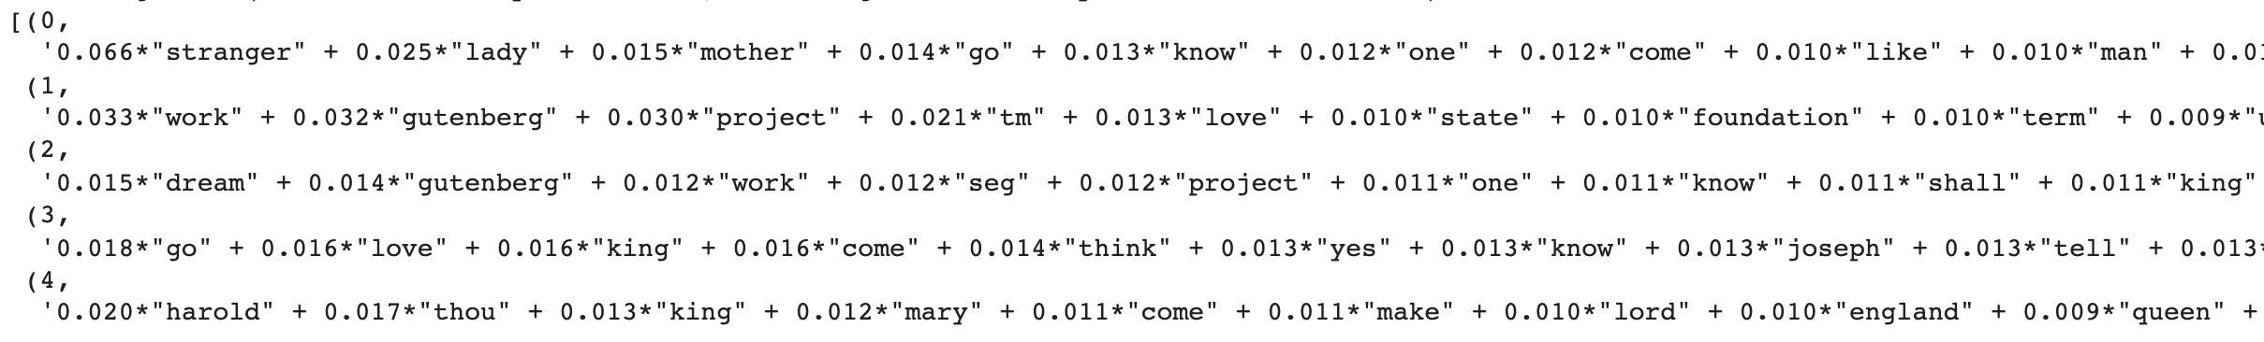
LDA (Latent Dirichlet Allocation)
Find top topics from the selected books
Multiple words belong to different topics
Inconsistent in accuracy
Little details on the topics

Slide 16
Feature Engineering
KNN(k nearest neighbor)
Random Forest Classifier
SVM(Support Vector Machines)
Logistic
Regression

Slide 17
Feature Engineering
Model Scoring & Fitting:
Fitting models with BOW.
Fitting models with TF-IDF
Fitting models without removing stop words and punctuation
Fitting models with lesser number of words

Slide 18
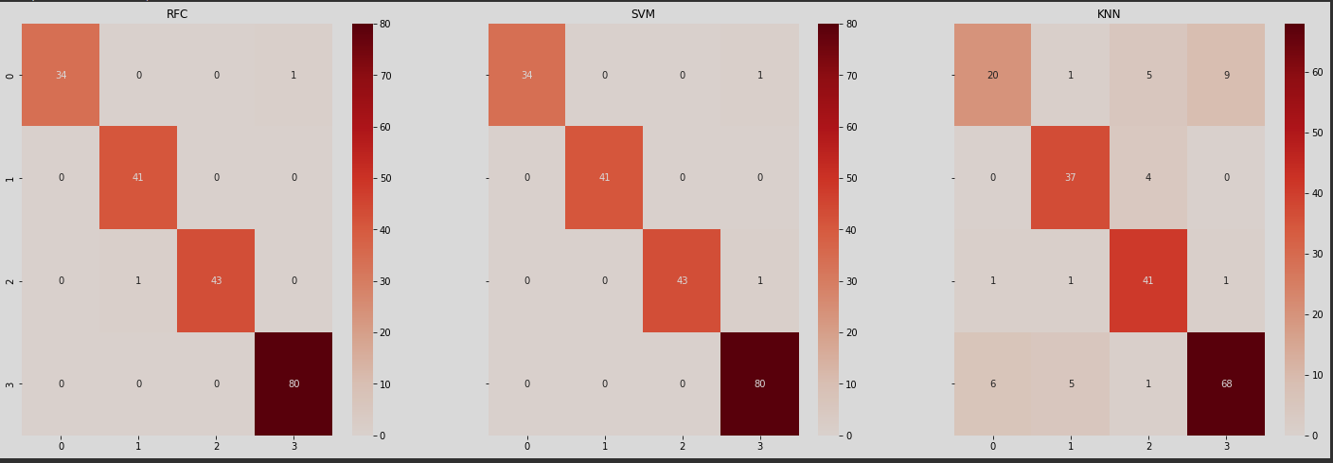
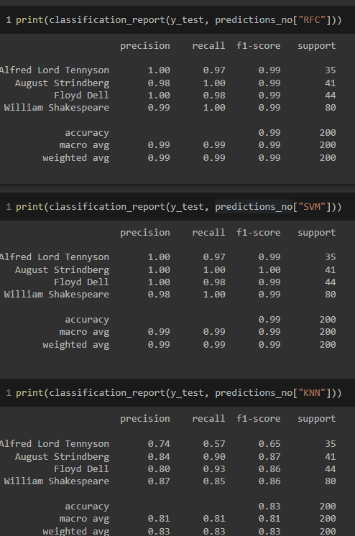
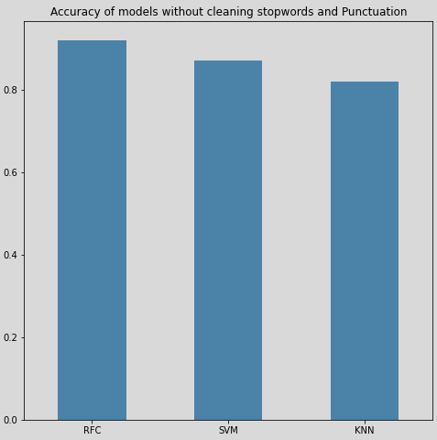
Fitting models without removing stop words and punctuation

Slide 19
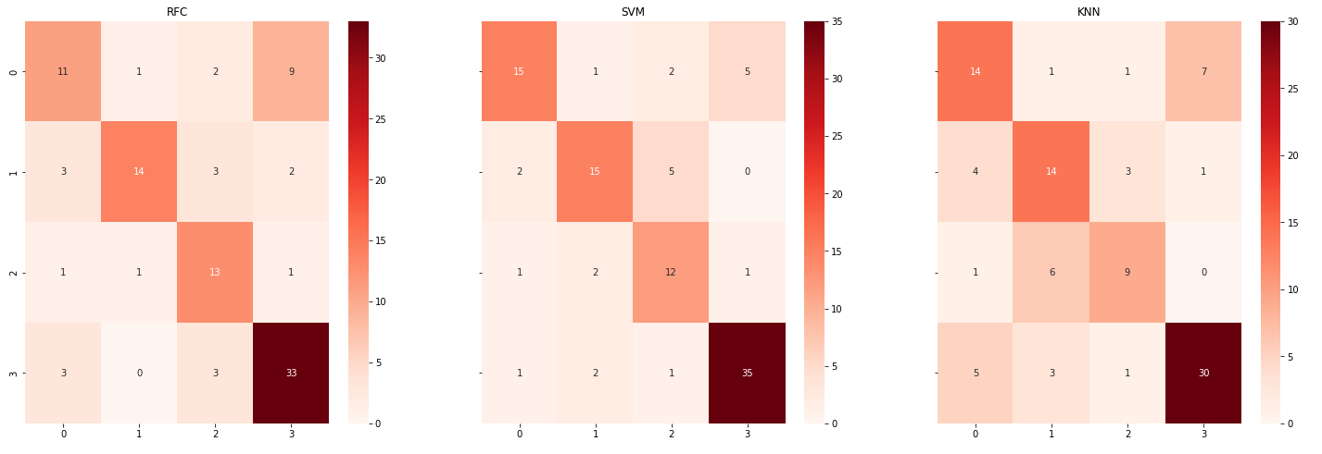
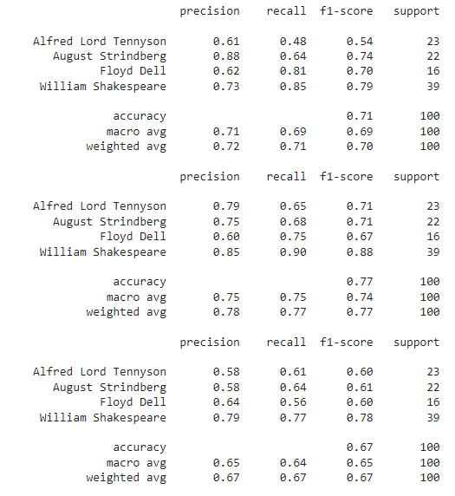
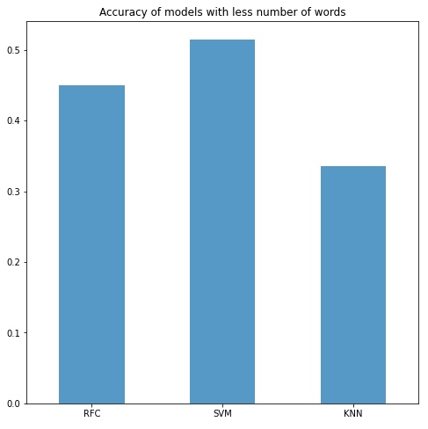
Fitting models with lesser number of words

Slide 20
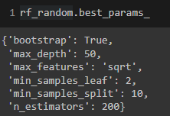

Champion Model
We agreed that RF with doc2vec is our champion model since it has the highest accuracy across the board.
We decide to partially do hyperparameter-optimization on the model but decided to not continue the optimization as the score was already very high. We decided to do 2-fold cross-validation with only 10 itereations on the randomized search since increasing both will also increase runtime

Slide 21
References
https://machinelearningmastery.com/gentle-introduction-bag-words-model/
https://towardsdatascience.com/a-machine-learning-approach-to-author-identification-of-horror-novels-from-text-snippets-3f1ef5dba634
https://towardsdatascience.com/hyperparameter-tuning-the-random-forest-in-python-using-scikit-learn-28d2aa77dd74
https://machinelearningmastery.com/confusion-matrix-machine-learning/
https://medium.com/nlplanet/two-minutes-nlp-doc2vec-in-a-nutshell-25be546a8342

Slide 22
Thank you

